Slide 1
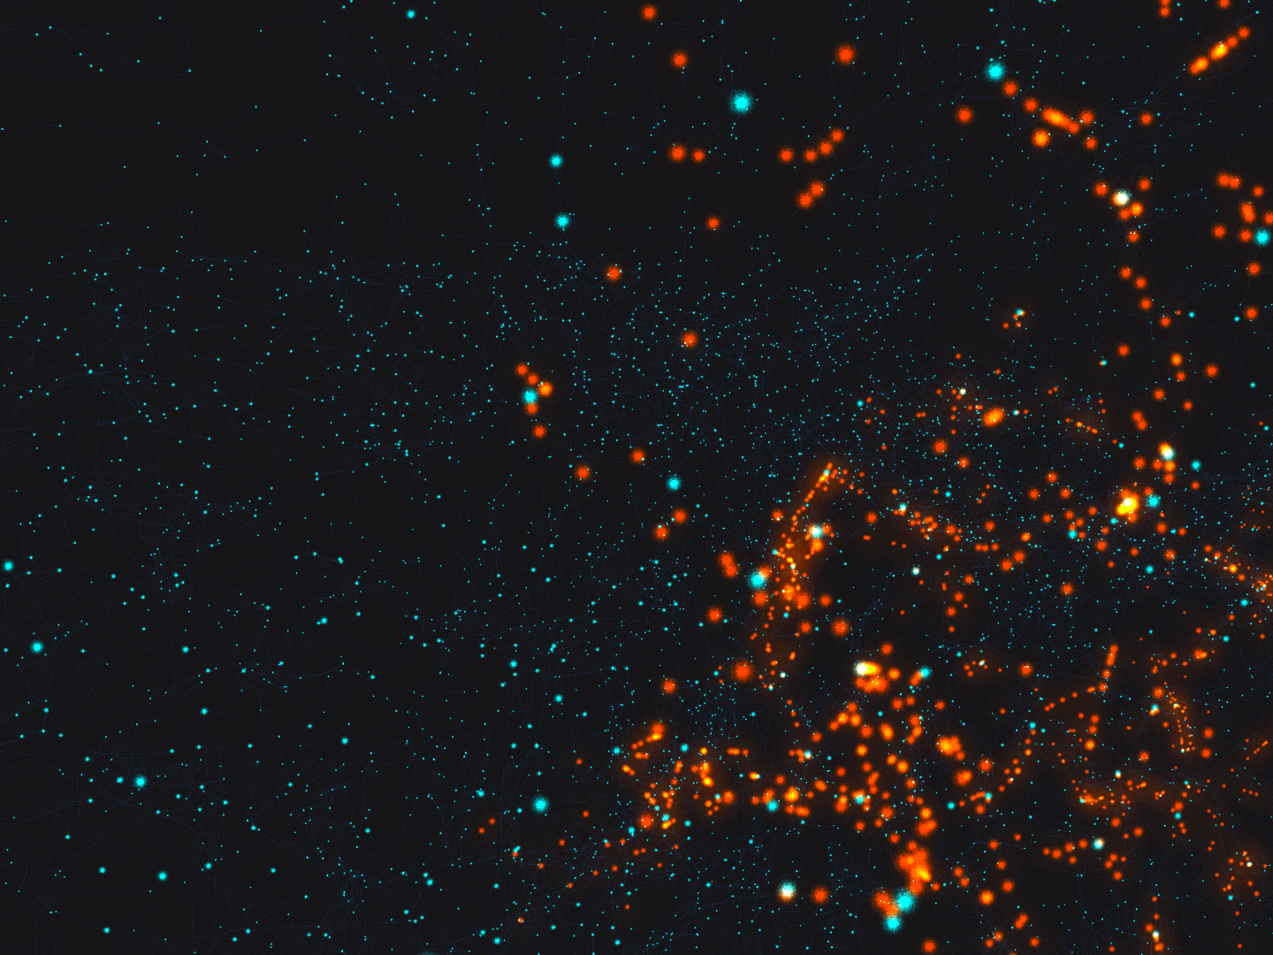
Introduction to
Machine Learning

Slide 2
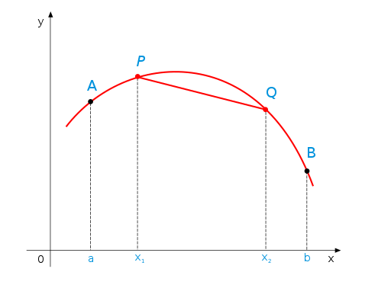
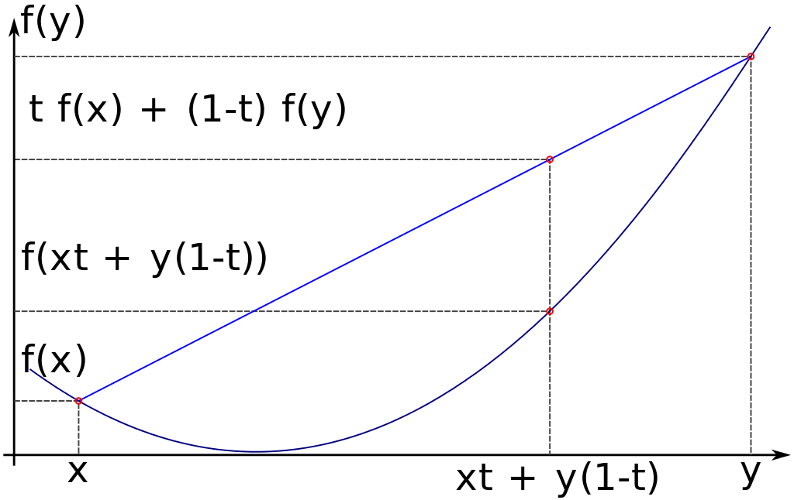
Convex and Concave Curves
Convex Curve
Concave Curve

Slide 3
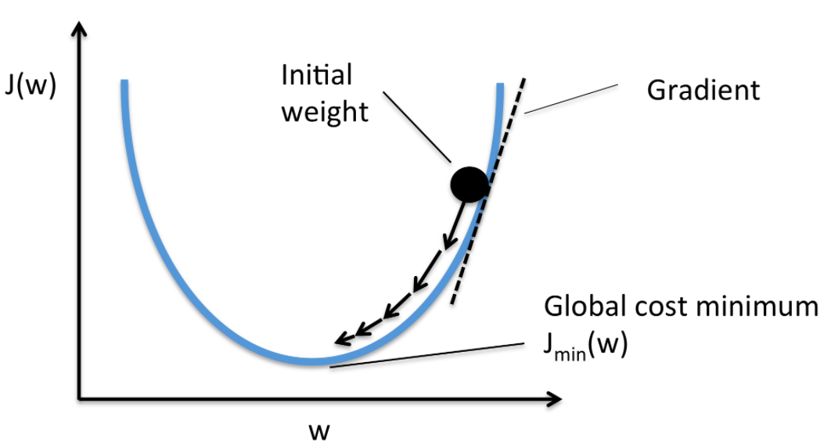
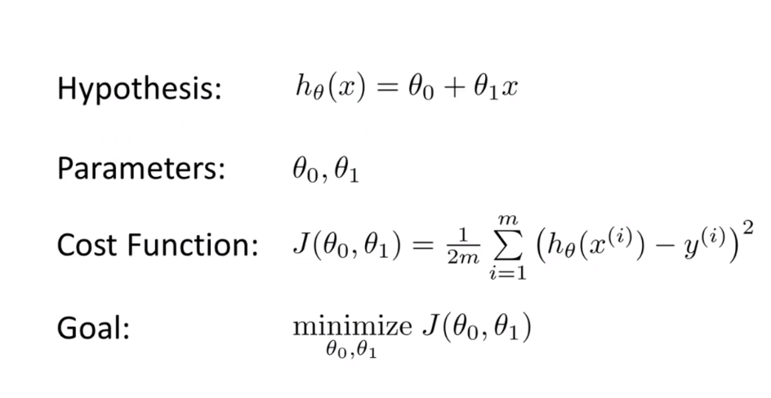
Optimizing Function

Slide 4
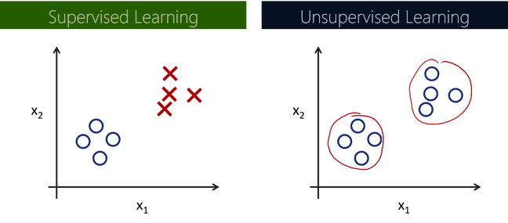
Input data is not labelled
Uses just input dataset
Clustering , Density estimation, Dimensionality reduction.
Input data is labelled
Uses training dataset
Classification , Regression
Unsupervised Learning
Vs
Supervised Learning

Slide 5
Optimization
Unsupervised Learning
Supervised Learning

Slide 6
Line of Best Fit

Slide 7
Classification

Slide 8
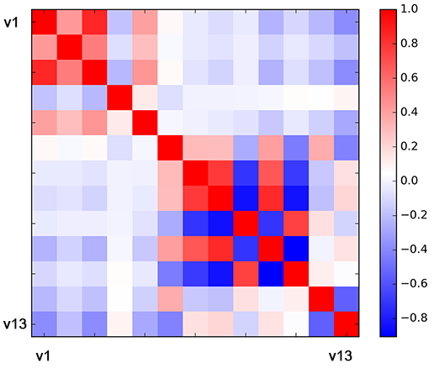
Features and Correlation

Slide 9
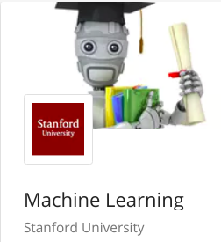
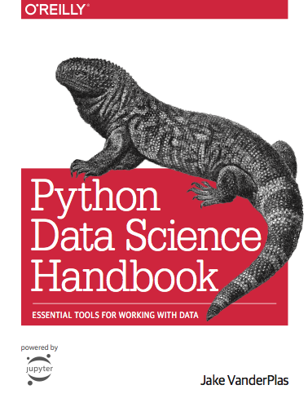
Further Resources
1. Machine Learning Course by Stanford University on Coursera.
(http://ml-class.org)
For getting started with Machine Learning.
Instructed by Prof. Andrew Ng.
Highly recommended for beginners.
2. Python Data Science Handbook
(https://git.io/fxbHt)
For learning essential machine learning libraries in Python
Easy to understand chapters for beginners.
Has an accompanying GitHub repository with all the code implemented in interactive Jupyter notebooks.

